Slide 1

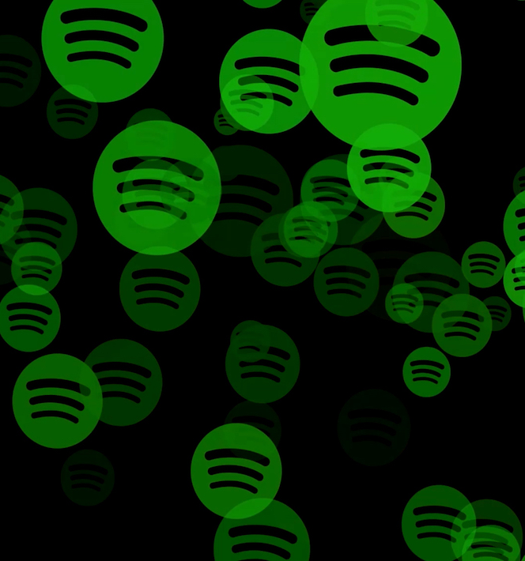
Spotify Data Analysis using PySpark

Slide 2

Executive Summary
What was analyzed:
This project aims to uncover insights from Spotify data using PySpark to inform music streaming strategies.
Main findings:
“Beatles” was Top artists by song mentions and average popularity.
Pop-Film was the most popular genres based on song ratings.
Predictive analysis: Key features influencing song energy with an R² value of 0.8287
Sentiment analysis: Emotional tone of track names and their relationship with Valence
Why it matters: Helps artists, labels, and Spotify improve audience targeting and playlist curation through data insights.

Slide 3
Project Motivation/Background
Why this project?
Spotify is one of the largest music streaming platforms, with millions of tracks.
Massive dataset representing diverse musical tastes.
Understanding music trends and listener preferences can inform decisions for artists, advertisers, and the platform.
Big data tools enable efficient analysis of complex datasets like Spotify's, uncovering hidden patterns, correlations and actionable insights.
Importance:
Identify popular artists and music genres.
Explore relationships between audio features and song popularity.
Identifying key drivers of song popularity and energy can optimize playlist curation and marketing efforts.
Sentiment analysis of textual data to extract insights and predict listener engagement.

Slide 4
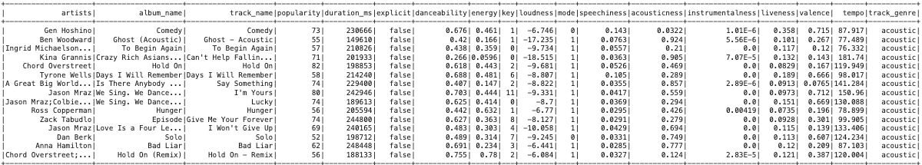
Data Description
Dataset Overview: Spotify Track Data
18 columns, including artist, track, popularity, audio features, and genre.
Key numeric fields: popularity, energy, danceability, valence.
Summary Statistics:
Total records: 114,000
Most Popular Artist: Beatles
Avg Energy of Most Popular Artist: 61.007
Most Popular Genre: Pop-Film
Dataset Source: Hugging Face

Slide 5
Data Preparation Activities
Data Cleaning:
Minimal missing data: Removed rows with null values.
Checked for outliers and non-normal distributions; transformations were unnecessary.
Big Data Ecosystem:
Tools: PySpark
Techniques: Loaded data into a Spark DataFrame and applied transformations for modeling.
Processing:
Aggregated data for artist popularity and genre analysis.
Feature selection for modeling (tempo, key, loudness, etc.).
Scaling features for model training

Slide 6
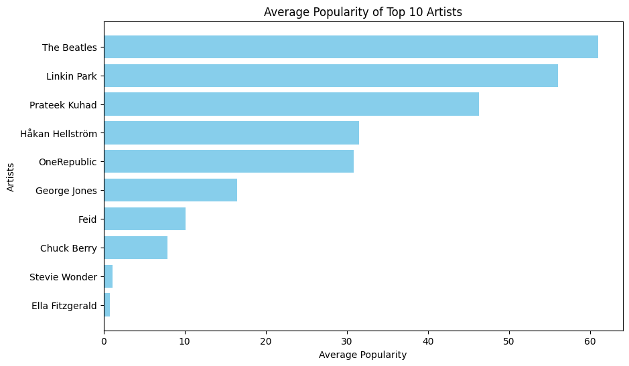
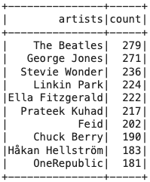
Data Analytics Techniques
Exploratory Data Analysis (EDA):
Analysis and Visualizations:
Top 10 artists based on song mentions and average popularity.

Slide 7
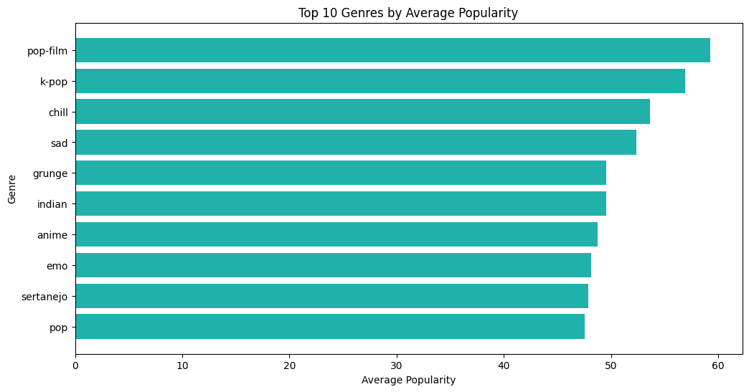
Data Analytics Techniques
Exploratory Data Analysis (EDA):
Analysis and Visualizations:
Top genres by popularity.

Slide 8
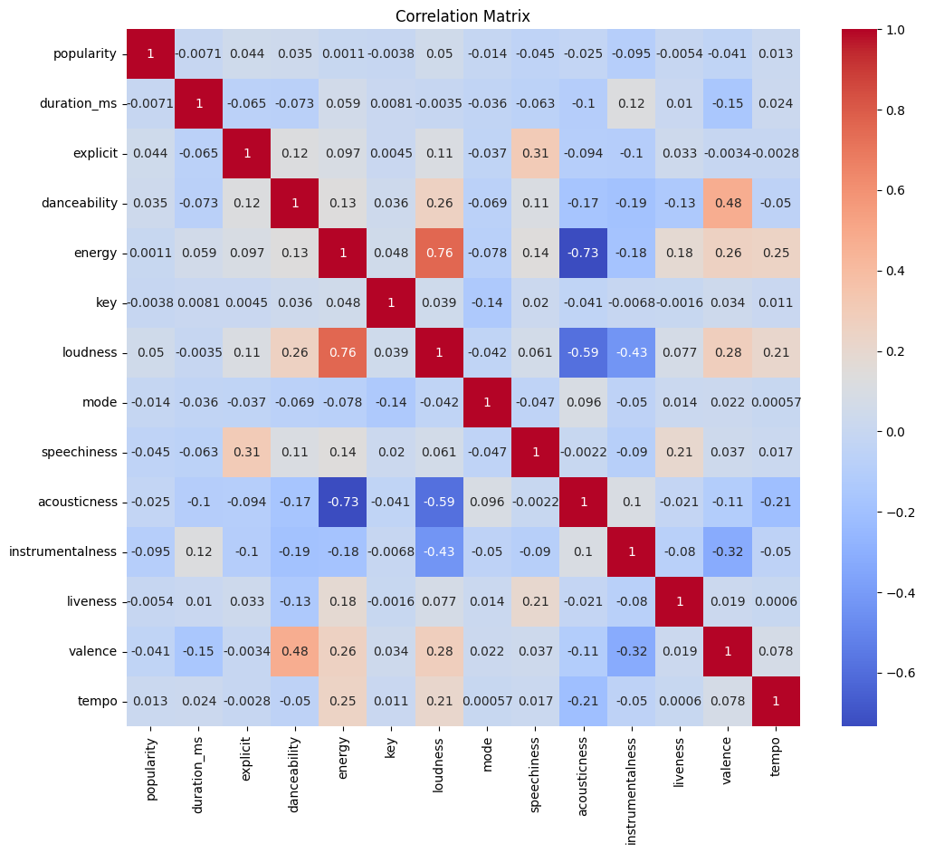
Data Analytics Techniques
Exploratory Data Analysis (EDA):
Correlation Analysis
Identifying relationships between variables using correlation coefficients
Insights: loudness and energy strongly correlated (0.76).
Insights: acousticness and energy strongly correlated (-0.73)

Slide 9
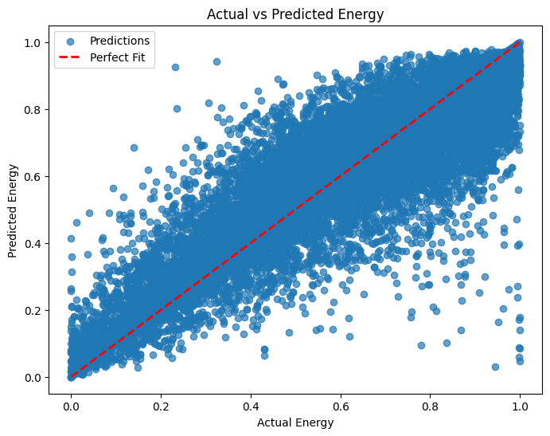

Data Analytics Techniques
Predictive Analysis:
Model: Random Forest Regressor.
Objective: Predict energy using tempo, key, loudness, etc.
Outcome:

Slide 10
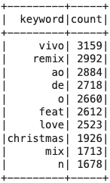
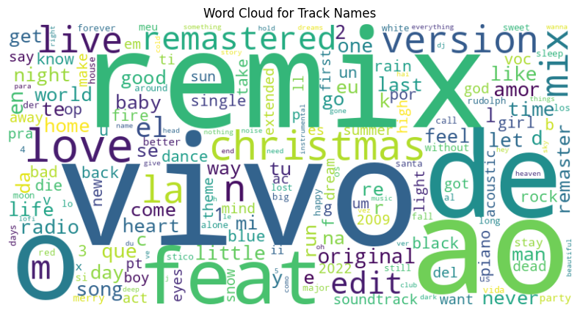
Data Analytics Techniques
Natural Language Processing (NLP):
Analysis:
Text mining for finding top 10 frequent words in track name and album name.

Slide 11
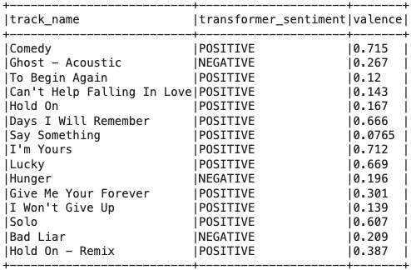
Data Analytics Techniques
Natural Language Processing (NLP):
Analysis:
Sentiment analysis: Positive or negative tone of track names linked to valence.

Slide 12
Findings
Key Insights:
Strong Correlations:
Artist popularity correlates with higher song popularity.
Energy with loudness, acousticness, danceability and valence
Random Forest Model Performance:
High accuracy in predicting song energy
Predictive model show tempo, key, loudness, acousticness, and instrumentalness influence song energy
NLP Analysis:
Common themes in song titles (love, heart, life)
Mixed sentiment in track names
Sentiment analysis reveals track names' tone aligns with valence values.

Slide 13
Business Implications/Intelligence
Actionable Steps:
Music Artists and Producers:
Optimize audio features to enhance listener experience
Music Labels:
Make informed decisions about artist signings and album releases
Streaming Platforms:
Personalize music recommendations by using popularity and genre insights
Create curated playlists
Improve user experience
Enhance artist recommendations by understanding key energy-influencing features.
Enable predictive tools for new song performance evaluations.
Target advertising campaigns based on sentiment and genre preferences

Slide 14
Conclusions
Summary:
Analyzed Spotify data using PySpark for EDA, predictions, and NLP.
“Beatles” was Top artists by song mentions and average popularity.
Pop-Film was the most popular genres based on song ratings.
Key features influencing song energy with an R² value of 0.8287
Emotional tone of track names and their relationship with Valence
Revealed actionable insights for popularity, energy, key words, and sentiment.
Importance:
Provides a foundation for data-driven decisions in music streaming and marketing.
Future Work:
Expand to full dataset analysis for analyzing trends and patterns
Incorporate lyrics for deeper sentiment insights
Develop advanced recommendation systems

Slide 15
References
Apache Spark. (n.d.). PySpark documentation: Getting started. Retrieved November 20, 2024, from https://spark.apache.org/docs/3.5.3/api/python/getting_started/index.html
Pandya, M. (n.d.). Spotify tracks dataset. Hugging Face. Retrieved November 20, 2024, from https://huggingface.co/datasets/maharshipandya/spotify-tracks-dataset
Hugging Face. (n.d.). DistilBERT base uncased fine-tuned SST-2. Retrieved November 20, 2024, from https://huggingface.co/distilbert/distilbert-base-uncased-finetuned-sst-2-english
scikit-learn. (n.d.). RandomForestRegressor (Version dev). Retrieved November 20, 2024, from https://scikit-learn.org/dev/modules/generated/sklearn.ensemble.RandomForestRegressor.html
Karau, H., & Zaharia, M. (2020). Learning Spark: Lightning-fast data analytics (2nd ed.). O’Reilly Media.

